Slide 1

Welcome
Logipool Infotech Pvt. Ltd

Slide 2
Character set
character set is the fundamental raw material of any language and they are used to represent information. Like natural languages, computer language will also have well defined character set, which is useful to build the programs. The characters in C are grouped into the following two categories: 1. Source character set a. Alphabets b. Digits c. Special Characters d. White Spaces 2. Execution character set a. Escape Sequence

Slide 3
Token
C Programming punctuation,individual words,characters etc are called tokens.
Tokens are basic building blocks of C Programming

Slide 4
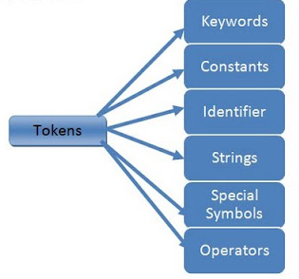

Slide 5
Token | Meaning
Keyword | A variable is a meaningful name of data storage location in computer memory. When using a variable you refer to memory address of computer
Constant | Constants are expressions with a fixed value
Identifier | The term identifier is usually used for variable names
String | Sequence of characters
Special Symbol | Symbols other than the Alphabets and Digits and white-spaces
Operators | A symbol that represent a specific mathematical or non mathematical action

Slide 6
Key-Words
Keywords are those words whose meaning is already defined by Compiler
Cannot be used as Variable Name
There are 32 Keywords in C
C Keywords are also called as Reserved words .

Slide 7
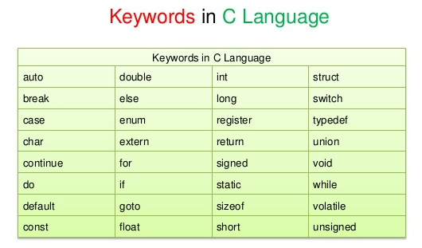

Slide 8
Identifiers
Identifier refers to name given to entities such as variables, functions, structures etc.
Identifiers must be unique. They are created to give a unique name to an entity to identify it during the execution of the program.
Example
int money;
double accountBalance;

Slide 9
Rules for naming identifiers
A valid identifier can have letters (both uppercase and lowercase letters), digits and underscores.
The first letter of an identifier should be either a letter or an underscore.
You cannot use keywords as identifiers.
There is no rule on how long an identifier can be. However, you may run into problems in some compilers if the identifier is longer than 31 characters.

Slide 10
variables
a variable is a container (storage area) to hold data.
To indicate the storage area, each variable should be given a unique name (identifier). Variable names are just the symbolic representation of a memory location
Example
int playerScore = 95;

Slide 11
A variable name can have only letters (both uppercase and lowercase letters), digits and underscore.
The first letter of a variable should be either a letter or an underscore.
There is no rule on how long a variable name (identifier) can be. However, you may run into problems in some compilers if the variable name is longer than 31 characters.

Slide 12
Literals
A literal is a value (or an identifier) whose value cannot be altered in a program. For example: 1, 2.5, 'c' etc.
Here, 1,2.5 and 'c' are literals. Why? You cannot assign different values to these terms.

Slide 13
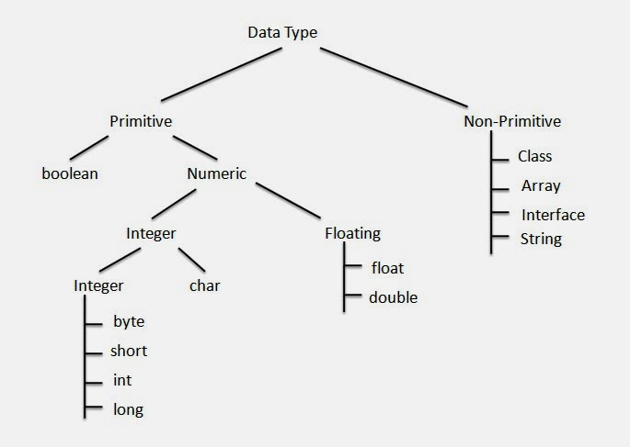
Data Types

Slide 14
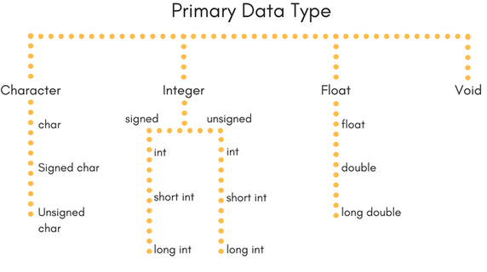

Slide 15
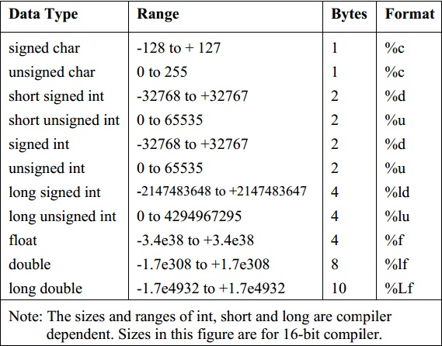

Slide 16
Data Types
C language has some predefined set of data types to handle various kinds of data that we can use in our program. These datatypes have different storage capacities.
C language supports 2 different type of data types:
Primary data types:These are fundamental data types in C namely integer(int), floating point(float), character(char) and void.
Derived data types:Derived data types are nothing but primary datatypes but a little twisted or grouped together like array, stucture, union and pointer. These are discussed in details later.

Slide 17
Type Casting
C we can have expressions consisting of constants and variables of different data types.
There are two type of conversions in C.
Implicit type conversion
Explicit type conversion

Slide 18
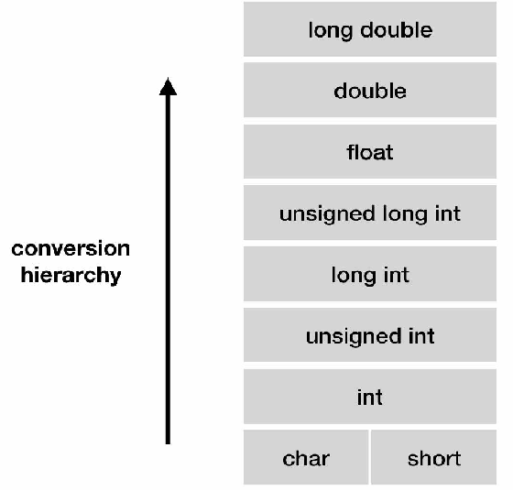
Implicit type conversion
C performs automatic conversions of type in order to evaluate the expression. This is called implicit type conversion.

Slide 19
If any of the operand in the expression is long double then others will be converted to long double and we will get the result in long double.
Else, if any of the operand is double then other will be converted into doubleand the result will be in double.
Else, if any of the operand is float then other will be converted into float and the result will be in float.
Else, if any of the operand is unsigned long int then others will be converted into unsigned long int and we will get the result in unsigned long int.
Else, if any of the operand is long int and another is in unsigned int then,
If unsigned int can be converted to long int then it will be converted into long int and the result will be in long int.
Else, both will be converted into unsigned long int and the result will be in unsigned long int.
Else, if any of the operand is long int then other will be converted to long int and we will get the result in long int.
Else, if any of the operand is unsigned int then other will be converted into unsigned int and the result will be in unsigned int.

Slide 20
Explicit type conversion
explicit type conversion we decide what type we want to convert the expression.
Syntax of explicit type conversion is:
(type) expression
Where, type is any of the type we want to convert the expression into.

Slide 21
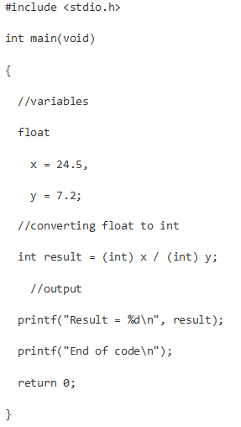

Slide 22
Thank You

